Slide 1
4COSCO11C.2 Web Design and Development
HTML Forms
Week 4

Slide 2
Form filling
It is possible to create forms as Web Pages, to request a user to enter some information.
When he/she has finished filling in the form, the entered data can be sent to a server-side script or to someone by email for processing.
The scripts resides and runs on the machine running the web server from which web pages are delivered.
A form is introduced by the tag <form> and terminated by the inverse tag </form>.

Slide 3
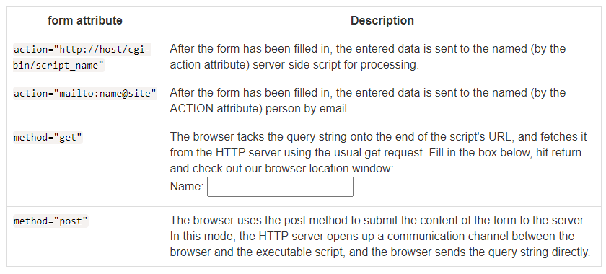
HTML <form>
The attributes of the <form> tag include:
Review Question - which is the default method?
Please note: server-side scripts will be covered next year.

Slide 4
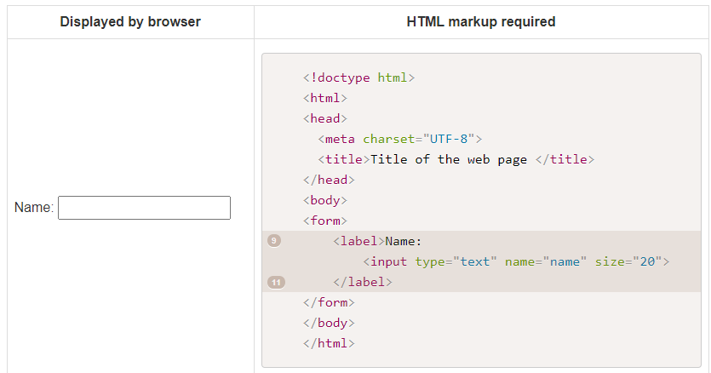
Text Input
A form to request the user to enter some text is shown below.

Slide 5
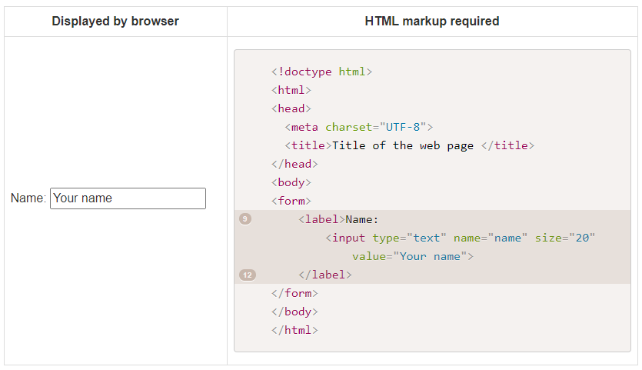
Contd
The data in the input field can be initialized to a particular value using the value attribute:

Slide 6
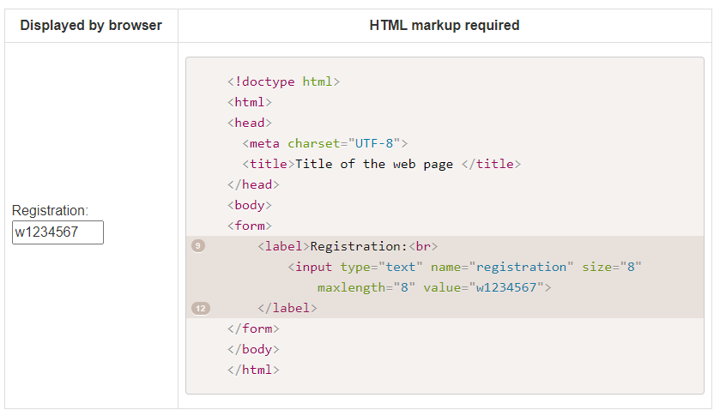
Contd
It is also possible to specify the maximum length for a text to be entered:

Slide 7
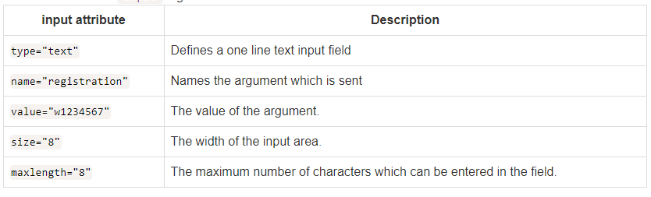
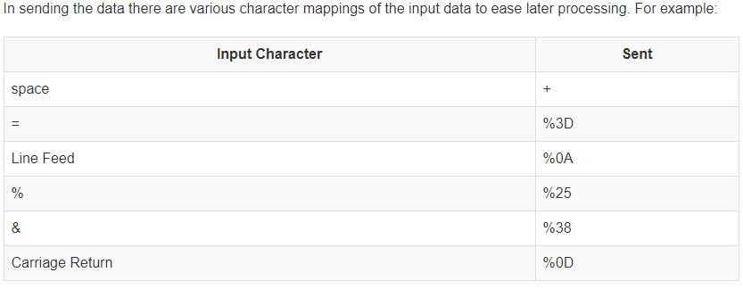
<Input> tag attributes

Slide 8
Labels
The <label> element represents a caption for the form element it is associated with. The <label> can also add as an accessibility aid to forms:
they can widen the element clickable area
they help screen readers identify fields on a web page

Slide 9
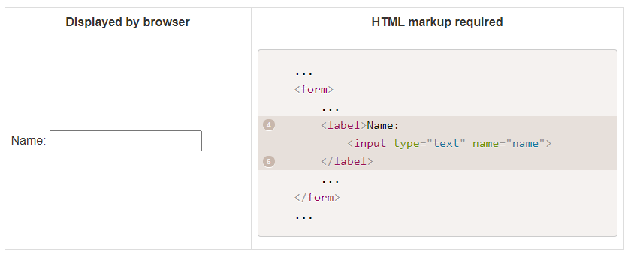
Implicit Labels
Implicit labels are wrapped around a form control. Implicit labels are not well suported in older screen readers, and are harder to style with CSS

Slide 10
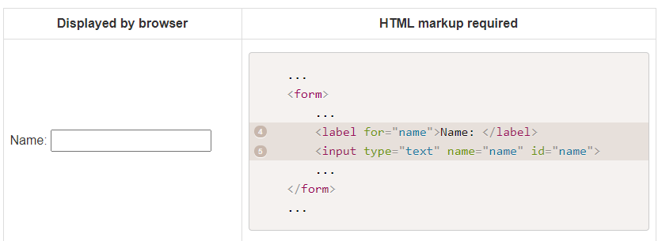
Explicit Labels
Explicit labels are separate from the form control, and linked to their form control via the for attribute.
The for attribute of the label has to match the id attribute of the form control it is linked to.
Explicit labels are well supported by screen readers and are easy to style using CSS. We will be using explicit labels in the notes.

Slide 11
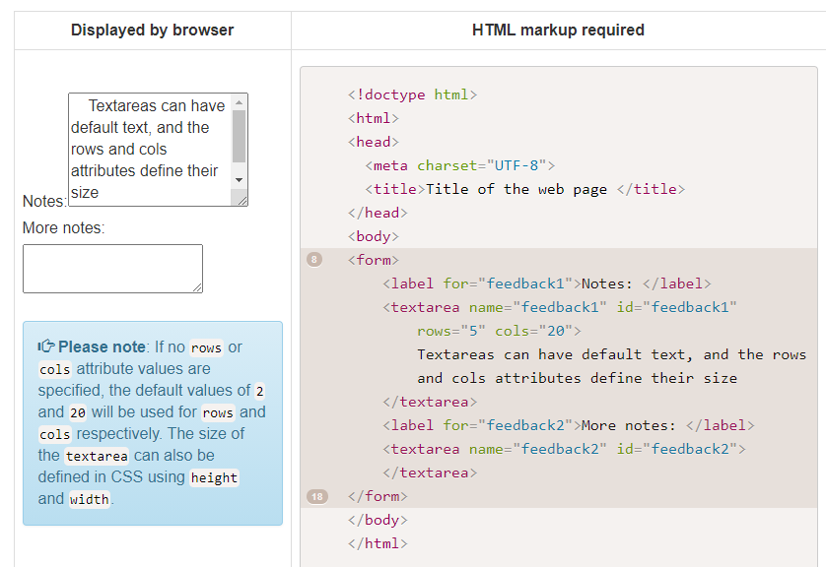
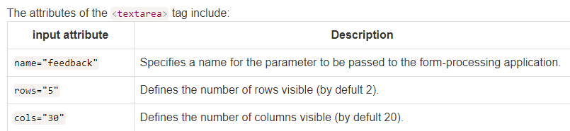
Multiple lines of text input - Textarea

Slide 12
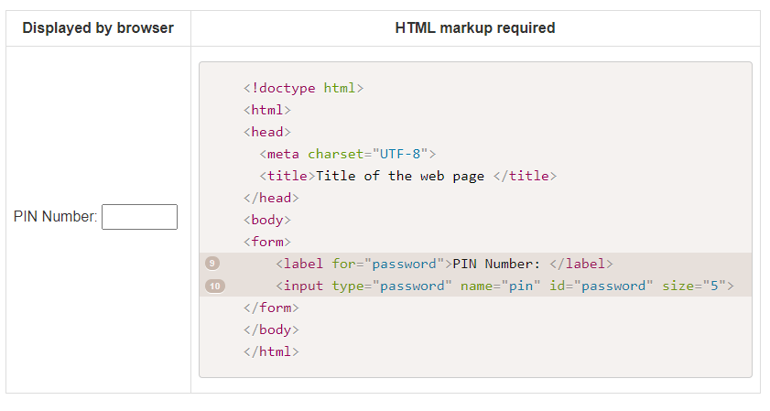
Password

Slide 13
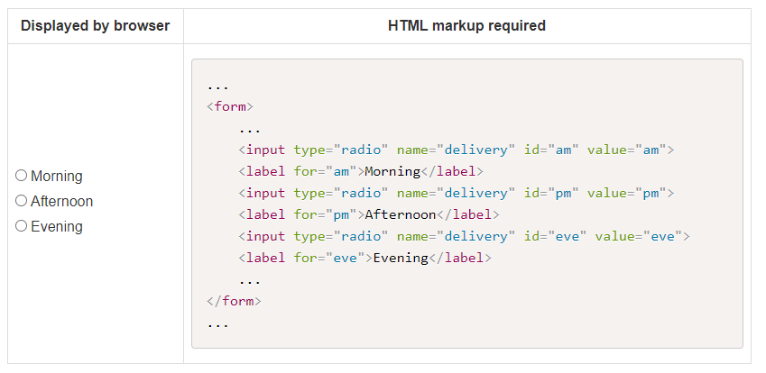

Radio Buttons

Slide 14
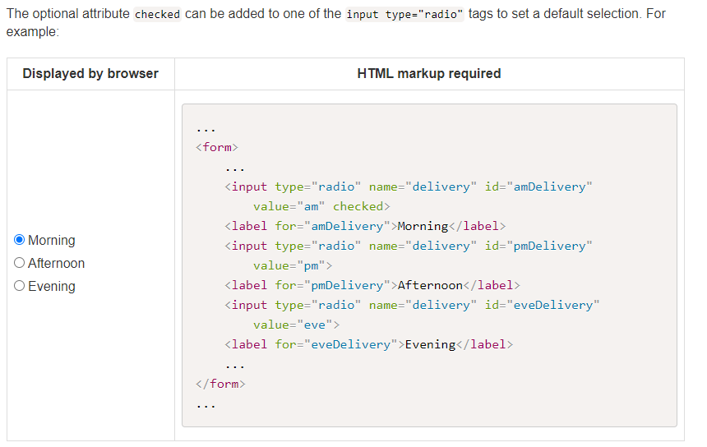
Contd

Slide 15
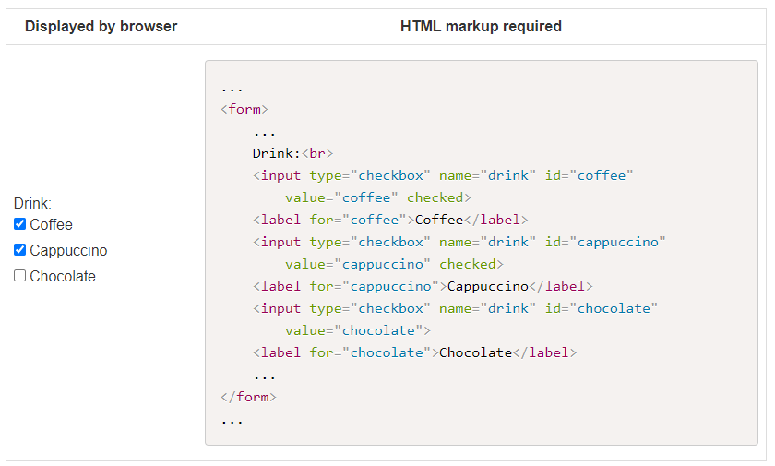
Checkboxes

Slide 16
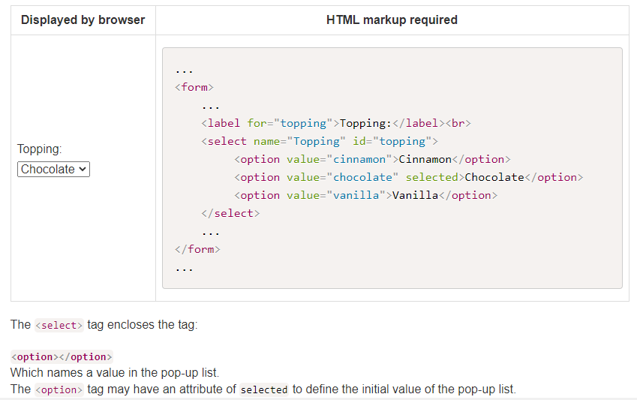
Pop up List
A form to allow the user to select an item from a pop-up list uses the <select> tag.
An example of a pop-up list is shown below:

Slide 17
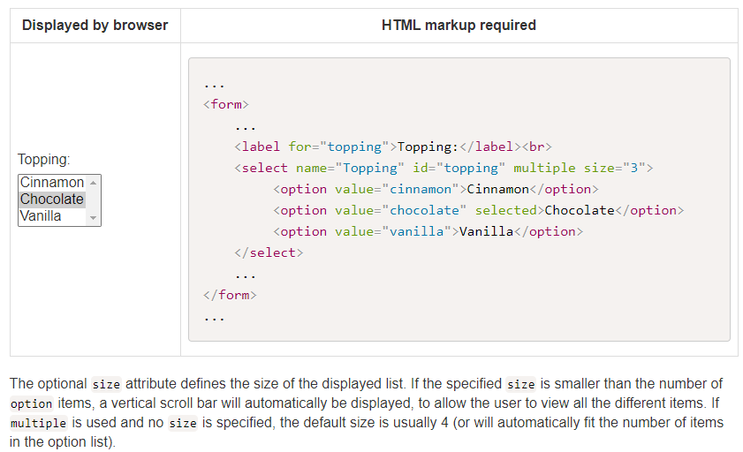
Scrolling List
A form to allow the user to select one or more item from a list uses the <select> tag with the multiple attribute.

Slide 18
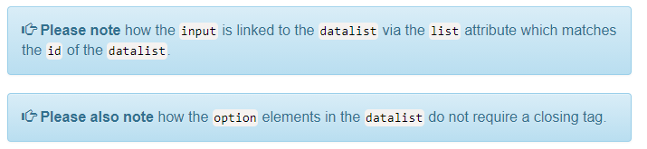
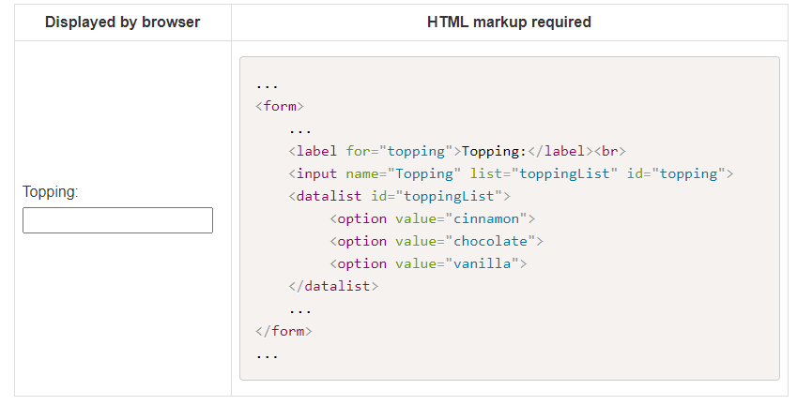
Data List
datalist is an HTML5 element.
The datalist represents a list of options available for its parent element.
The datalist can be paired up with an <input type="text" list="idOfList“>

Slide 19
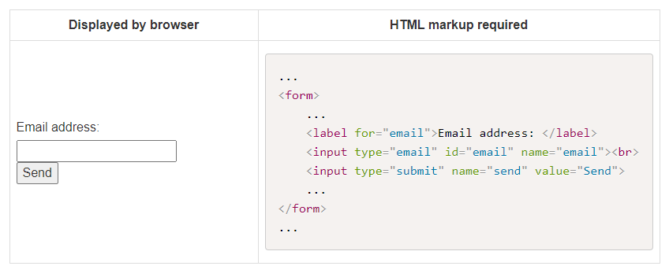
Email input field
email is an HTML5 input type.
Browsers that support this input type will automatically check the validity of the format of the data entered and alert the user if the format is invalid.
If the browser doesn't support this input type, it will automatically fall back to the type="text"

Slide 20
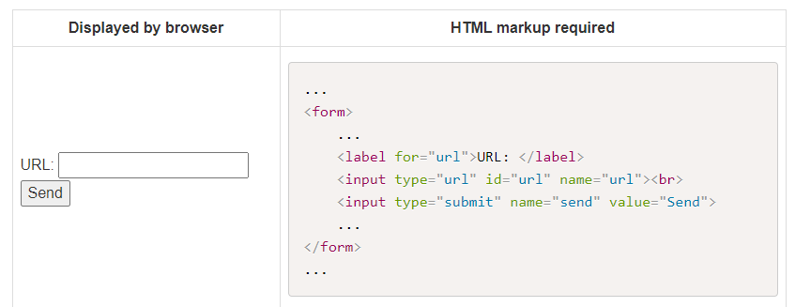
URL input
URL is an HTML5 input type.
Browsers that support this input type will automatically check the validity of the format of the data entered and alert the user if the format is invalid.
If the browser doesn't support this input type, it will automatically fall back to the type="text

Slide 21
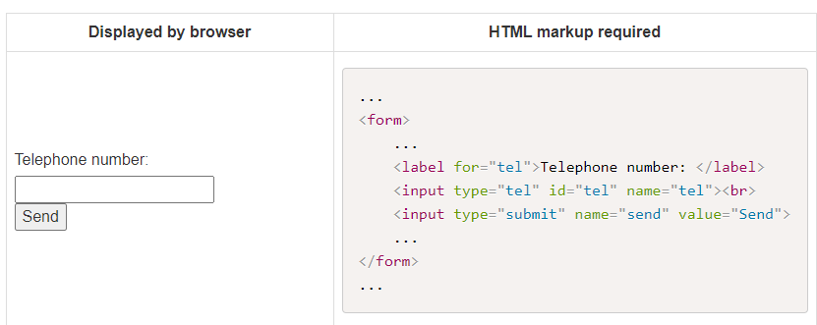
Tel input field
Tel is an HTML5 input type.
Browsers that support this input type will automatically check the validity of the format of the data entered and alert the user if the format is invalid.
If the browser doesn't support this input type, it will automatically fall back to the type="text

Slide 22
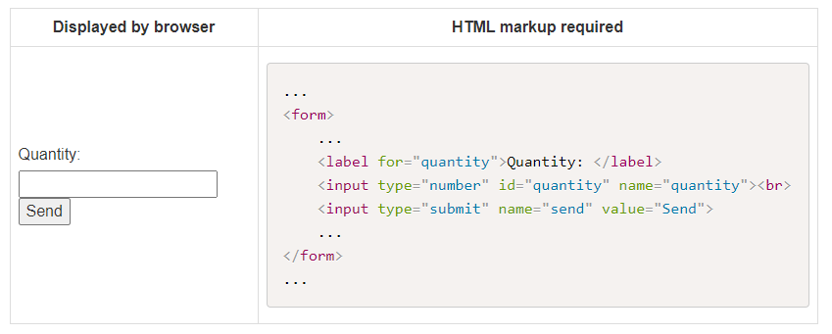
Number input field
number is an HTML5 input type.
This input type is designed to let the user enter a number.
Browsers that support this input type will automatically check the validity of the format of the data entered and alert the user if the format is invalid.
The browser may also display up and down arrows for the user to click on to increase and decrease the value entered.
If the browser doesn't support this input type, it will automatically fall back to the type="text"

Slide 23
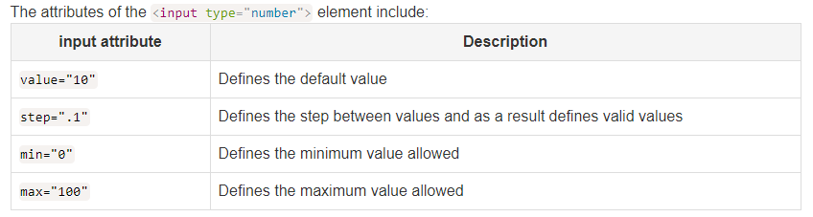
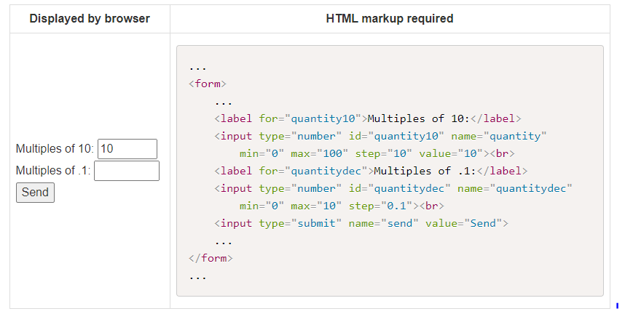
Contd

Slide 24
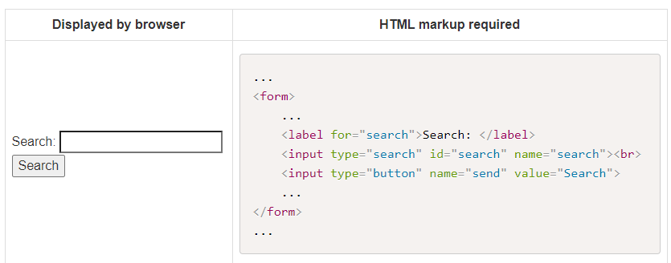
Search Input field
search is an HTML5 input type.
This input type is designed to let the user enter a search query. Browsers that support this input type may style it differently from the text input and may automatically offer the possibility to clear the input field.
If the browser doesn't support this input type, it will automatically fall back to the type="text"

Slide 25
Date picker
There are a number of attributes that will create a date picker using the input element:
date is an HTML5 input type.
This input type is designed to let the user enter a date. Browsers that support this input type will automatically check the validity of the format of the data entered and alert the user if the format is invalid.
The browser may also display a date picker. If the browser doesn't support this input type, it will automatically fall back to the type="text".
You can provide a default value in the format yyyy-mm-dd, and you may use min and max date values if you want to retrict the valid date.
Current Browser Support for date and time input

Slide 26
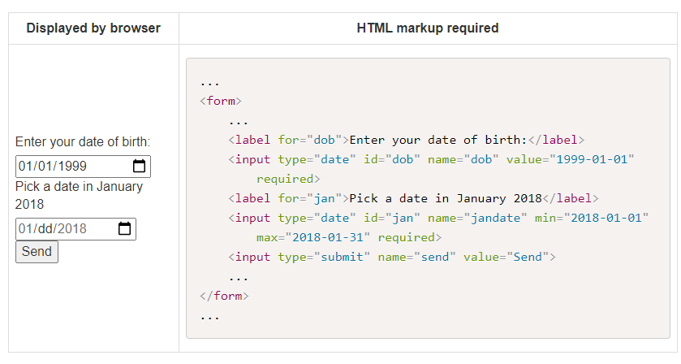
Date

Slide 27
Datetime-local
datetime-local is an HTML5 input type.
This input type is designed to let the user enter a date and time in the user's local time zone.
Browsers that support this input type will automatically check the validity of the format of the data entered and alert the user if the format is invalid.
The browser may also display a date and time picker. If the browser doesn't support this input type, it will automatically fall back to the type="text".
You can provide a default value in the format yyyy-mm-ddThh:mm, and you may use min and max date and time values if you want to restrict the valid date/time.

Slide 28
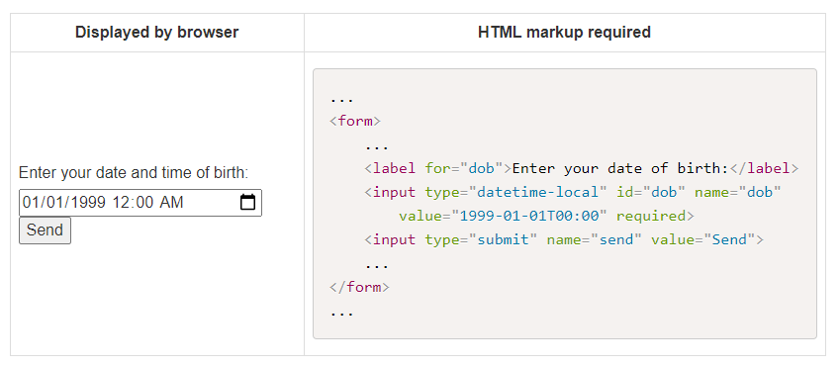
Datetime-local

Slide 29
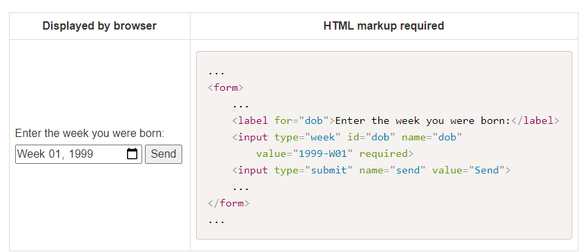
Week
week is an HTML5 input type.
You can provide a default value in the format yyyy-Www, and you may use min and max date and time values if you want to restrict the valid week.

Slide 30
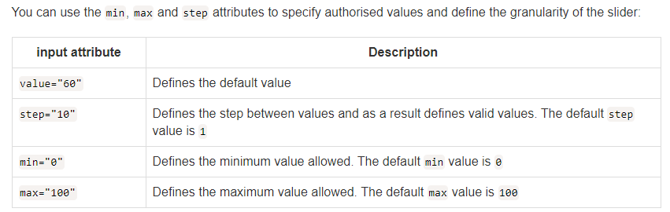
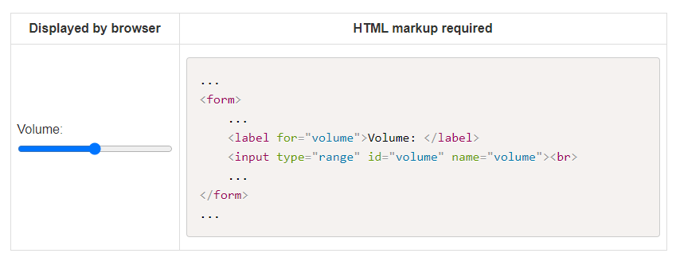
Range input field
range is an HTML5 input type

Slide 31
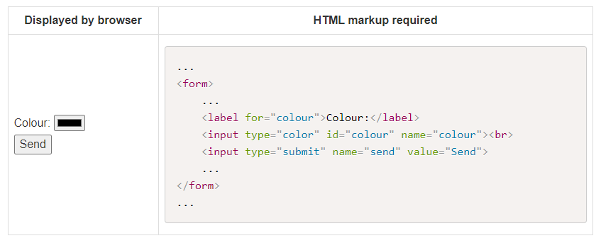
Color input field
color is an HTML5 input type.
This input type is designed to let the user enter a color in hexadecimal format.
Browsers that support this input type may style it differently from the text input and may automatically present a colour picker.
If no default value is specified, the default #000000 is used.

Slide 32
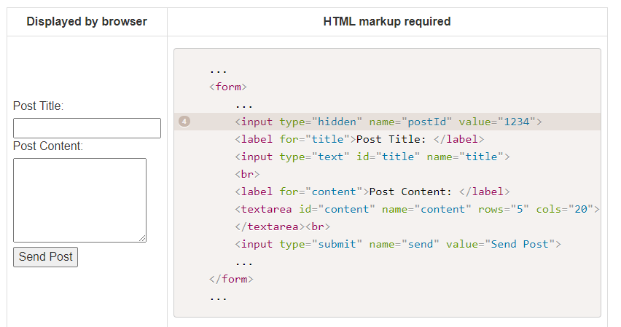
Hidden field in a form
Hidden fields are used to send parameters you don't want to appear in the displayed form.
The name and value of the hidden field are incorporated into the parameter list sent, but do not have any visible counterpart on the form.

Slide 33
Buttons
There are several ways to create a button on a form, and there are several types of buttons available.
You can create a button by adding the type="button" attribute to the input element, or by using the button element.
These two types of button will have no default behaviour, other than being a clickable button, and you will need to add some JavaScript to add event listeners to these buttons and add behaviour (for example calculating the total price of an order).
Please see in the last section of this document for details on Submit buttons and Reset buttons.

Slide 34
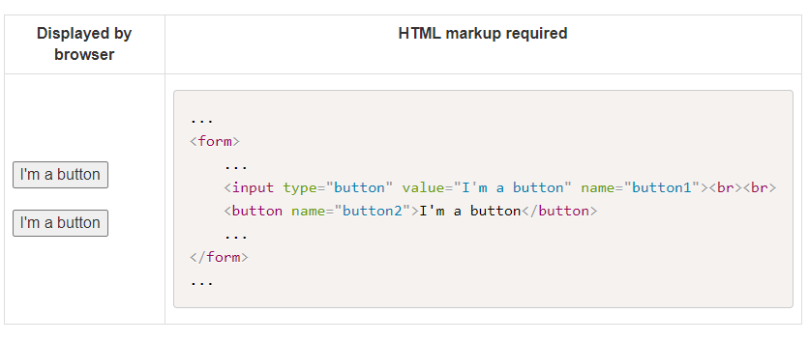
Buttons

Slide 35
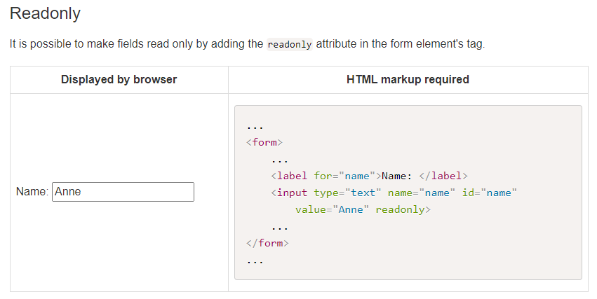
Useful attributes

Slide 36
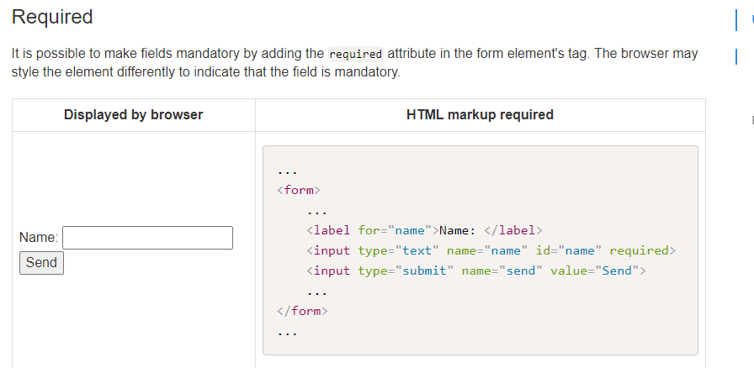
Useful Attributes

Slide 37
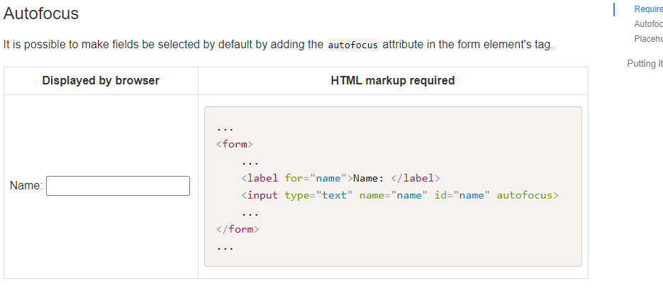
Useful Attributes

Slide 38
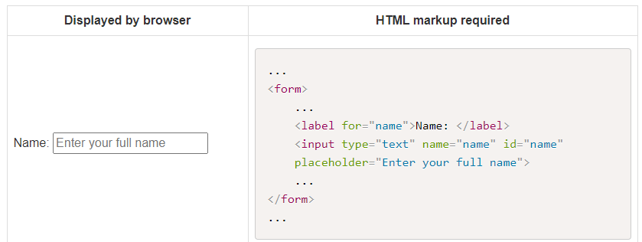
Useful Attributes
It is possible to add a placeholder in the input field by adding the placeholder attribute and spacifying a value in the form element's tag.
The advantage of the placeholder over a default value, is that the placeholder automatically disappears when the user starts entering text, and will be displayed again if the user deletes what they entered, hence the information is never lost, and never needs additional user interaction to be removed.

Slide 39
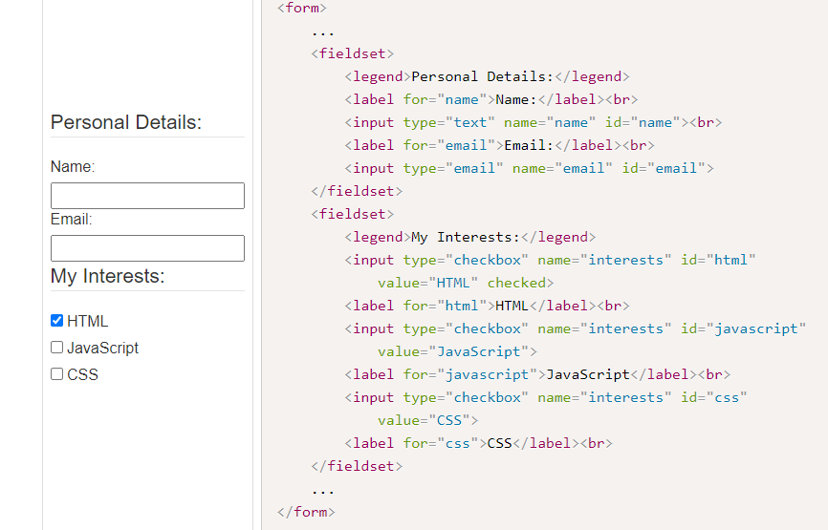
Fieldset and Legend
The fieldset element togehter with its corresponding legend are used to group several form controls and labels together.

Slide 40
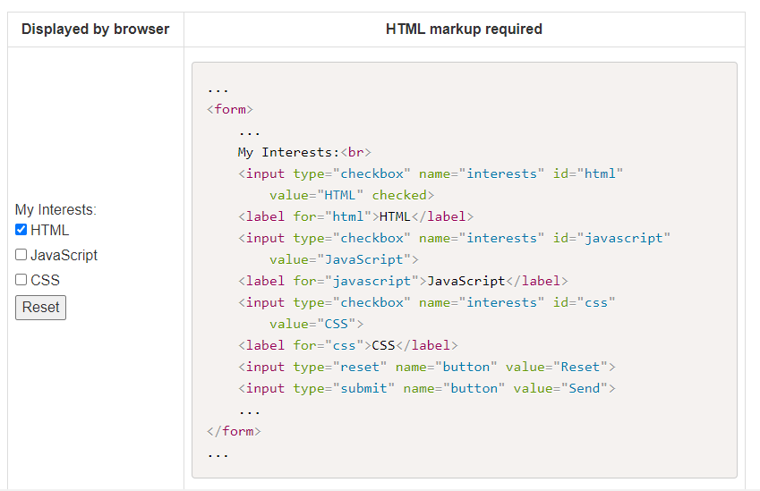
Reset
The <input> tag with an attribute of type="reset" is used to reset the values in a form back to their default value.
For example, the following form may be reset to its initial values by pressing the "reset" button.

Slide 41
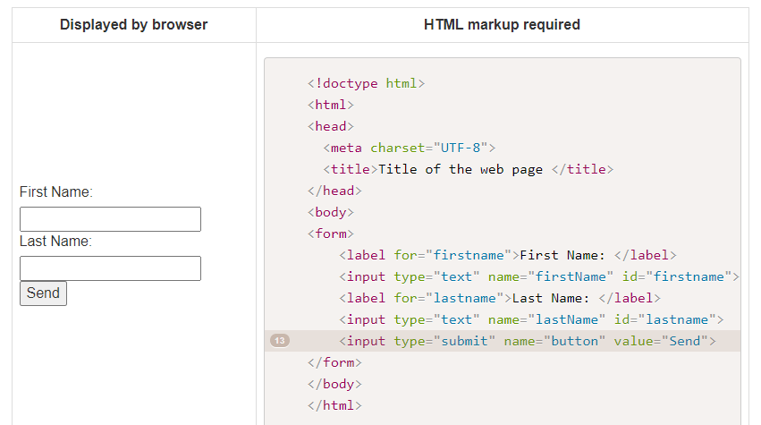
Submit Button
When a form contains a single entry field, the information is sent as soon as the user presses the "return" key.
However, most forms will contain multiple form elements and therefore require a "submit button", generated by an additional tag <input type="submit"> to cause the submission of the input data:

Slide 42
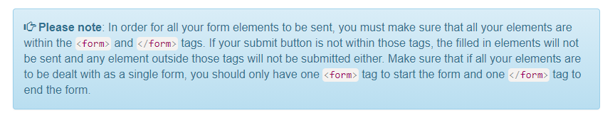
Form submission
When there are several elements in a form the data sent to the server-side script is composed of the individual elements concatenated together with an &.
For example, when the Send button is pressed and the name Jane Smith is entered, then the following information will be sent: firstName=Jane&lastName=Smith&button=Send
https://www.w3schools.com/tags/tryit.asp?filename=tryhtml_form_method

Slide 43
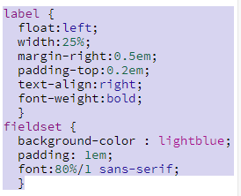
Styling the content of a form
If you only want to style a specific input type, you can use attribute selectors:
input[type=text] - will only select text fields
input[type=password] - will only select password fields
input[type=number] - will only select number fields
etc..

Slide 44
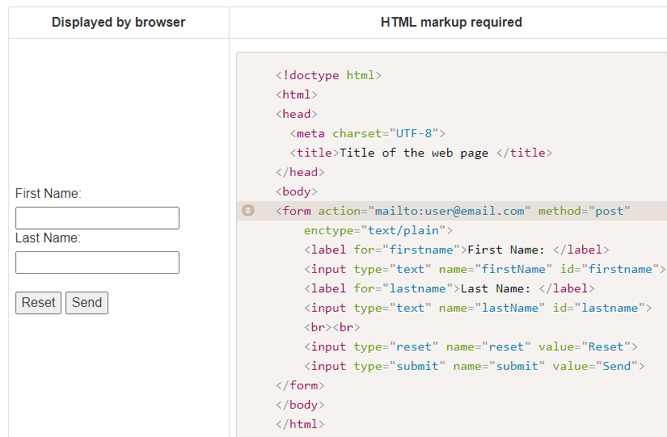
Emailing the content of a form
By adding the following attributes: method="post" action="mailto:Your e-mail address" enctype="text/plain" to your form element.
When a user fills in and submits the form, the content of the form is posted to your e-mail address. Of course for this to work, the mail preferences must be set up in the users browser.

